Slide 1
Angular Routing
Grouping and Component-less Routes
Lecture 6
By James(Jin) Wang
12/26/2021

Slide 2
Outline
Grouping Routes
Component-less Routes

Slide 3
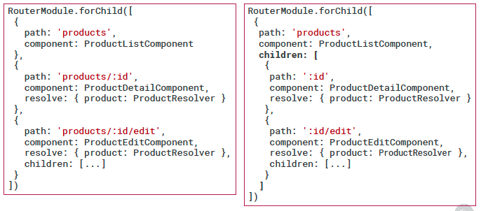
Grouping Routes
  Grouping Routes

Slide 4
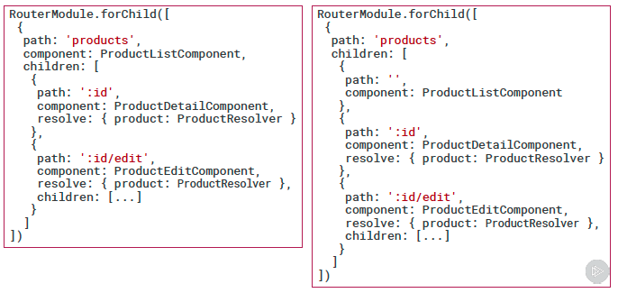
Grouping Routes
  Component-less Routes
  Demo: grouping routes

Slide 5
Summary

Slide 6
Assignment

Slide 7
Self Study
  Angular Routing
  https://app.pluralsight.com/library/courses/angular-routing

